Slide 1
Game Ai Presentation
Finns Adventures

Slide 2

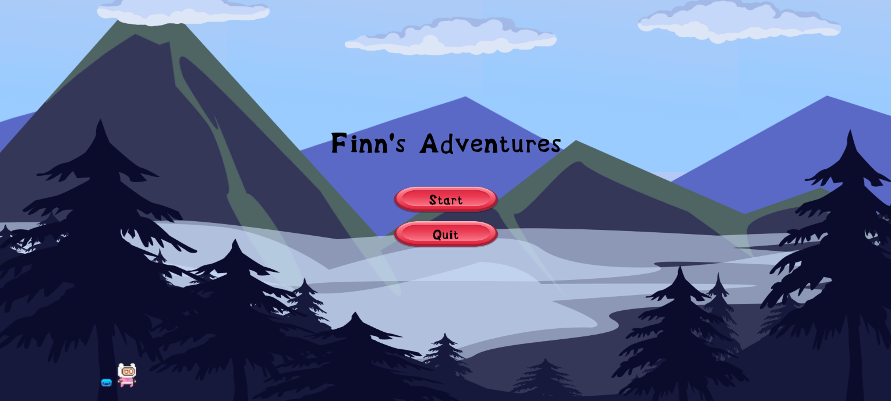
What is the game I created
The game I created is a basic platformer called Finns Adventures.
In this game I used many different Physics materials to add different effects to the game
My game has 3 levels, a main meu, a story screen, a game over screen and last but not least a game complete screen.

Slide 3
What physics materials did I use
In this game I used many different physics materials such as :
Friction Joint
Buoyancy Effectors
Hinge joints
Rigidbody 2d
Different colliders: Circle, box, polygon 2D
Physics Material

Slide 4
How I implemented Joints
I Implemented 2 types of joints into my game:
Hinge Joint: I used the hinge joints in 2 ways the first way I used it I made a swinging spike that swings 180 degrees left to right from above that when it hits you, you lose a life. To make it I added a platform a chain and the spike. I make the spike a child of the chain and added the hinge joint to the chain to give the swinging effect. The second wy I used it is I added it to a plank to make a trapdoor so when you step on it moves and you fall to your death
Friction Joint: I added a friction joint to a platform so when you step on it it falls out from beneath you uncovering spikes that you fall onto and die

Slide 5
How I implemented effectors and Physics Materials
I used one type of effector in my game called a buoyancy effector. I added this effector to water and lava to give the affect you are swimming through it.
With the water I made it very bouncy, so it looks like you're floating in the water
Then with the physics material I used them on the water and lava to make it seem like the current is pushing you to the left making you fight your way while swimming

Slide 6
Conclusion
Overall I added quite a good bit of physics to my game using different style of physics
But with more research I think I could make this game better by adding new types of joints and effectors and maybe even try implementing triggers into my game

